Slide 1
KS 2
Multiplication
Building on learning in KS1

Slide 2
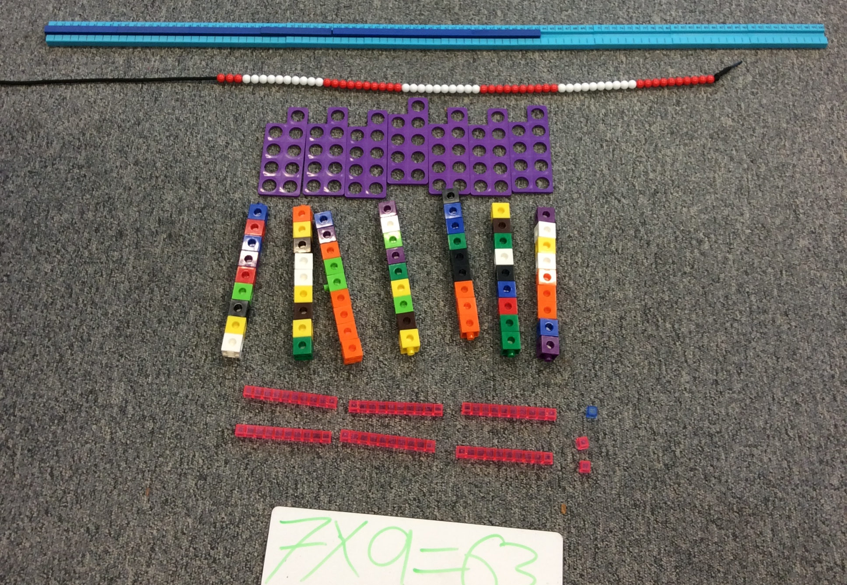


Slide 3
For each set of tables facts:
• Step counting
• Practical grouping of objects (arrays, number line model, bar model)
• Commutativity 3x2 = 2x3
• Inverse
• Understanding one table is related to another: 5x and 10x
• Links between facts through doubling and halving (3x2 with 3x4; 3x4 with 3x8 etc) ,
• Related facts, particularly division
•Place Value links of multiplying (dividing) by 10 and 100
• Identifying ‘non-multiples’ and concept of a remainder
• Links with fractions

Slide 5
Learn-its Demonstration

Slide 6
Multiplication Tables check - End of Year 4
The purpose of the MTC is to determine whether year 4 pupils can fluently recall their multiplication tables.
The MTC will be statutory from the 2019/20 academic year - current Year 3 will be the first year group to take the test.
The Times Tables Check Is Online And On-Screen
Children will get 6 seconds from the time the question appears to input their answer. This means that children must be able to read, recall and enter their response within 6 seconds.

