Slide 1
Welcome to our Parents Maths Workshop
Numicon Advocate School

Slide 2
Maths Teaching and Learning at Bartons
‘GOOD Mathematics is not about how many answers you know…
It’s how you behave when you don’t know.’ (John Holt)

Slide 3
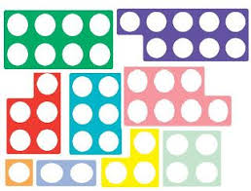
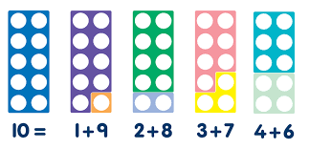
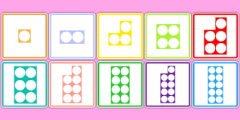
The Numicon approach uses shapes and manipulative equipment to represent maths concepts clearly for children.
We use and develop the cpa approach:
Concrete (using resources to handle & solve Problems)
Pictorial (pupils show their working)
Abstract (answers are recorded in a mathematical way)

Slide 4
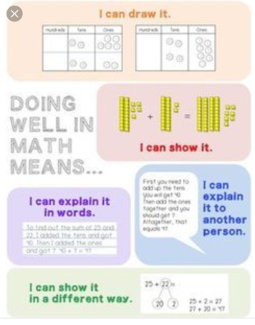
The Numicon approach develops thinking and deeper understanding.
We develop the children’s skills so that they can do this
This is called Mastery.
Mastery is not about doing pages of ‘sums’; it is about showing deeper and secure understanding of maths – being able to ask and answer questions about their work.

Slide 5
Teaching and learning with Numicon at Bartons has enabled our children to:
Have a love of Maths
Gain confidence and understand that making mistakes is essential to learning
Have consistent quality first teaching
Have excellent progression planned through all of the Maths strands
Make accelerated progress
This positive development was recognised by Ofsted.
.

Slide 6
We want everyone to succeed in Maths. Numicon allows us to deepen and extend the children’s learning by adopting the ‘low threshold, high ceiling’ concept where everyone can explore their learning and go further. Have a look at this clip Fleas in a jar

Slide 7
We teach whole class Maths lessons to ensure that everyone has the opportunity to go further and so no pupil is ‘set’ like the fleas in the jar. The important part is expectation.

Slide 8
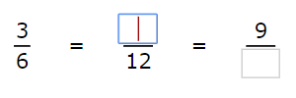
Supporting Your Child At Home With Maths.
Using the resources on your table, have a go at one of these maths problems:
KS1:
Alice has 23 sweets. Her sister has 34 sweets. How many sweets do they have altogether.
KS2: Fill in the missing boxes.

