Slide 1
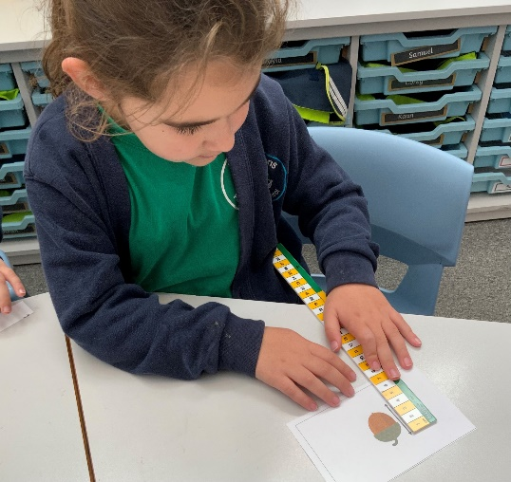
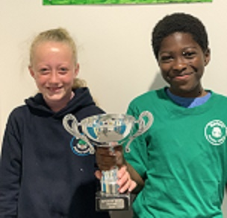
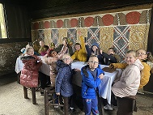
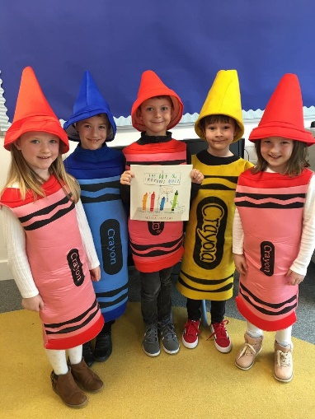
Welcome to Bartons primaryschool

Slide 2
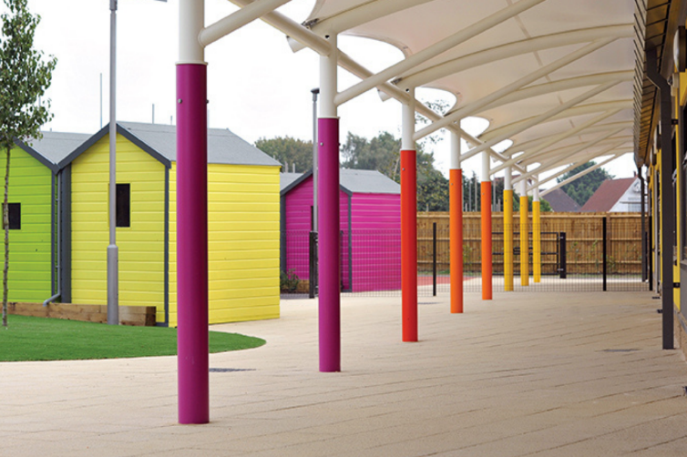
Bartons Primary School
In September we will have 207 pupils on roll.
Elm Class – Year R
Beech Class – Year 1
Chestnut Class – Year 2
Hazel Class - Year 3
Ash Class – Year 4
Lime Class – Year 5
Cedar Class – Year 6

Slide 3
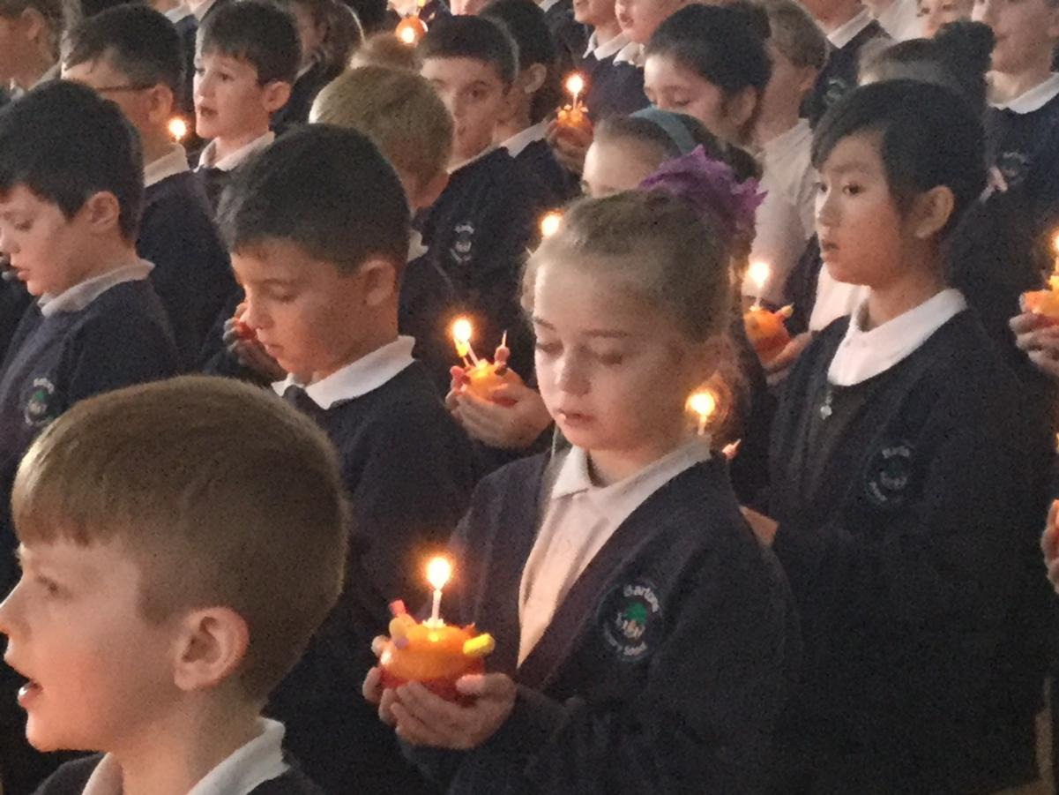
Team Bartons
The school has been on this site for 8 years.
The school has experienced staff who teach all subjects.
Classes are supported by talented teaching assistants.
At Bartons we value a creative curriculum which enables all learners to be catered for.
There are school trips and visitors that come to the school to enhance learning.
We are an Advocate Numicon Maths School.
Our motto is Dream, Believe, Achieve!

Slide 4
Our Learning Values and Skills
Bartons Primary School has an agreed set of Core Learning Values and Skills which underpin and drive the curriculum and all of the exciting learning in school. All lessons are planned with these core values and skills in mind and they are displayed around the school to ensure that the children know what they are and what is expected of them.
Bartons Primary School Values
Independence Autumn H/T 1 | Respect Autumn H/T 2 | Communication Spring H/T 1 | Happiness Spring H/T 2 | Responsibility Summer H/T 1 | Creativity Summer H/T 2
Bartons Primary School Skills
Being Confident | Empathy | Speaking and Listening | Self-Esteem | Persevering | Being Imaginative
Self-Motivated | Tolerance | Sharing | Pride | Reflecting | Experimenting
Organised | Honesty | Collaborating | Self-Belief | Improving | Discovering
Self-Control | Fairness | Persuading | Building Relationships | Problem Solving | Taking Risks
Self-Determination | Equality | Discussing | Enjoyment | Managing Distractions | Questioning
Resilience | Team | Encouraging | Positivity | Having Ambition | Inspiration
 |  | Co-operating |  |  | Be Yourself

Slide 5
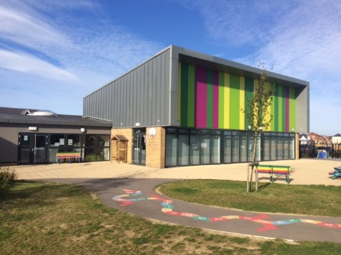
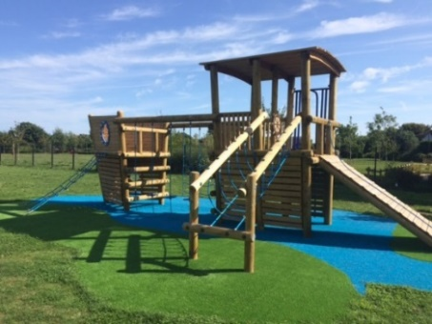
Bartons Primary School
Bartons is the only oversubscribed primary school in the Bognor area.
As a smaller school relationships amongst staff and pupils are strong. We are a family school where the children and families are known well by the staff.
We encourage parents to be involved in the life of the school and value positive partnerships.
We have high expectations of the children including behaviour.

Slide 6
School Timings
The school gates are open from 8.45am.
Staff open the classroom doors at 8.45am and the children are welcomed into class.
Children must be in school by 9am. They will be marked late after this time.
There will be a change to the start time of school in January – this will be earlier and details will follow.
Parents must call the school by 9am on each day of any absence stating the reason.
We have an Early Morning Club in the hall from 8.15am. There is a booking facility and there is a small daily charge (£1) towards resources and staffing.
Lunch is between 12 and 1 o’ clock.
School ends at 3.15pm.

Slide 7
Parking
Most families walk to school.
Parking can be busy and so if you have to drive please park in the outer streets and walk up to school.
Please don’t park across private driveways of our neighbours so we maintain good relationships.
Parents are not allowed to park in the staff car park.
We do have scooter and bike racks for safe storage of bikes and scooters. They must be locked.
They must also not be ridden on the school premises.
Bikes and scooters must be taken home at the end of the day.

Slide 8
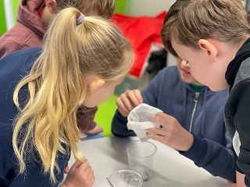
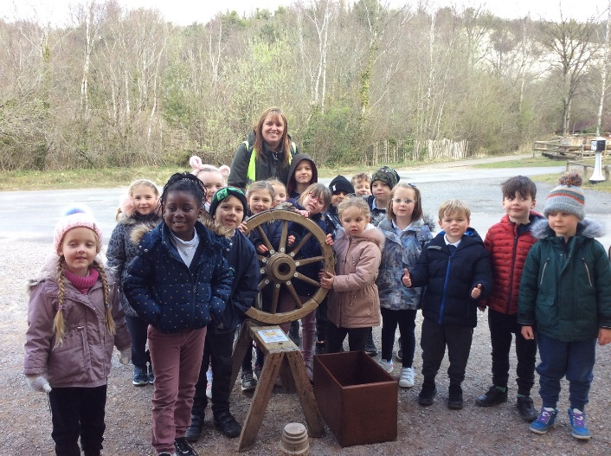
Curriculum
We have a creative curriculum and subjects are taught in a cross-curricular way through topics.
Subjects are linked to maximise learning opportunities for all children.
We value academic achievement but also recognise the importance of the arts, music and sports.
Class pages highlight the learning every term on the school website.

Slide 9
Important Information
If your child is sick or has diarrhoea then they are not allowed to be in school until 48 hours after the last bout. This stops the spread of infection and in line with West Sussex guidelines.
If your child is ill then parents must telephone the school office before 9am to report the absence. There is an answer phone facility to do this.
Routine medical and dental appointments must not be made during the school day.
Attendance is monitored by the Governing Body and Ofsted and so schools have to address poor attendance. This would be deemed under 95%.
Family holidays will not be authorised during term time.

Slide 10
Useful Info
Bartons has a parent information communication facility ParentMail which is a main point of contact from us to you. Please ensure we have an up to date mobile number and emails address for you where we can contact you to keep up to date with information i.e. school closures, special events, notices. There is an App for ParentMail which is very useful for receiving instant messages.
Social Media – Bartons has a strict policy about the use of social media. The policy can be viewed on the school website. Not all parents give permission for photographs to be used online so filming and photographs of other children is restricted i.e. class assemblies, sports day. The school has always had a great relationship with parents and so if there are any concerns, please come and speak to us directly rather than take to social media. The Governing Body and LA take a strong view of comments made about staff which is of a derogatory nature.

Slide 11
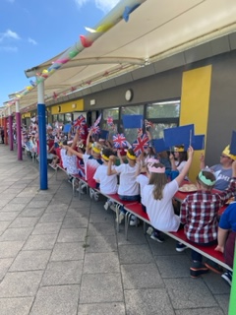
School Lunches
All Year R, 1 and 2 pupils are entitled to a free hot lunch called the Universal Free School Meal.
Menus can be viewed on the Chartwells website.
Special diets can be catered for but parents must contact Chartwells themselves.
Please make sure you have told us whether you will be taking up this entitlement or not.

Slide 12
School Uniform
Our uniform is a dark blue Bartons sweatshirt/cardigan with a white Bartons polo shirt.
School trousers, shorts and skirts must be grey. Please do not buy BLACK.
Uniform and P.E kit can be ordered from JW Sports (in Bognor High Street).
For P.E the children need a house t-shirt, dark plain shorts and trainers. Dark fleece and joggers can be worn in the colder months.
Children must wear black sensible school shoes (not boots) to school. Trainers are not allowed.
Children with long hair must have it tied back.
No jewellery must be worn (only small stud earrings).
NO jewellery is allowed for P.E lessons.

Slide 13
We have a very active Friends group (FoBs) who support the school very well.
They organise discos, fairs and activities throughout the year which are well supported. All parents are automatically members and the planning committee always welcome new people getting involved and new ideas.
They have a fundraising Facebook page which will let you know what’s going on.

Slide 14
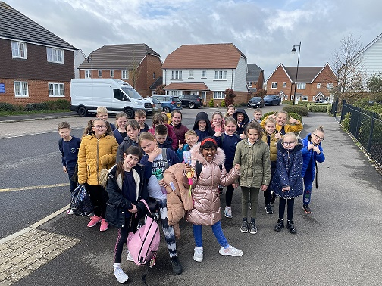
From all of the staff welcome to Team Bartons and we hope that you will be very happy here. Bartons is a wonderful school with lovely children and excellent staff.

